Slide 1


DEPARTMENT OF COMPUTER SCIENCE & ENGINEERING
(Affiliated to VTU, Belagavi, Approved by AICTE, New Delhi and ISO 9001:2015)
Under the guidance of-
“Ms. Lakshmi Priya”
Assistant Professor, CSE Department, ACSCE.
Internship Seminar Cooridinator- “Ms. Ganga B M”
E-COMMERCE WEB DEVELOPMENT USING DJANGO
Presenting my role and responsibilities as an intern web developer at
Prabkrishna Tech Solutions Private Ltd, Punjab.
Presenter: Syamili S N (1AH18CS101)

Slide 2
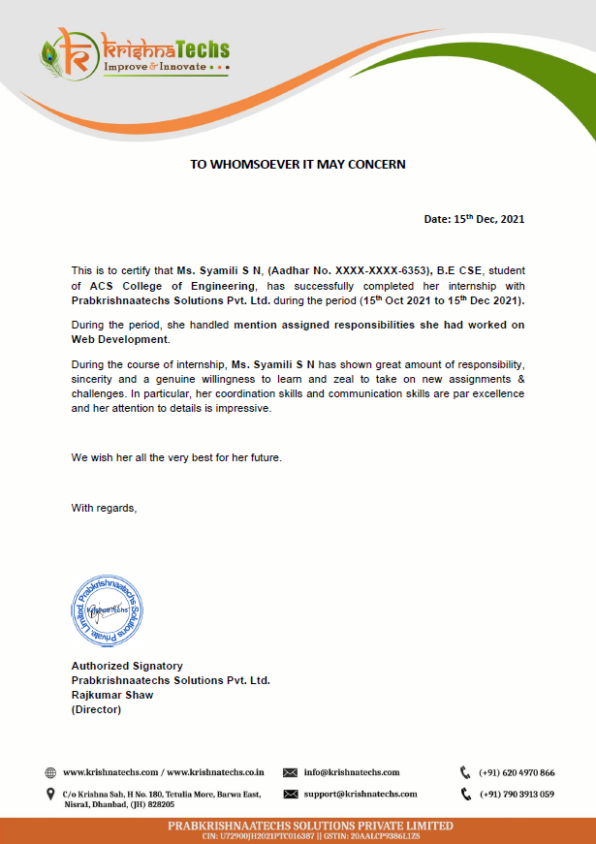
CERTIFICATE OF COMPLETION

Slide 3
ABSTRACT
The scope of this internship includes research and implementation of an E-commerce website using the python-based web framework called Django. The functionality of the website includes the creation of user accounts, viewing and adding products to the shopping e-cart. The website is not only limited to shopping but also includes a vendors feature where a customer can create his very own vendors account using which he can add his own products, which he is interested in selling on the FastEcommerce website. There is also the administrator site where the admin can monitor the products which are added to the website and is solely responsible for the modification and updating the database and migrations. Finally, after placing the order the consumer is able to checkout from the e-cart and make his payments by entering valid credit card information in a secure portal.

Slide 4
LIST OF CONTENT
AGENDA
ORGANIZATION & LIVE PROJECT
DESIGN CONSIDERATIONS
ER DIAGRAM
UML DIAGRAM
DATABASE SCHEMA
TASK PERFORMED
WHY DJANGO? ZEN OF PYTHON
RESULTS
CONCLUSION
FUTURE ENHANCEMENT
REFERENCES

Slide 5
AGENDA
1. Working on the implementation of FastEcommerce.co, an online ecommerce website for the group company.
2. Conducting research about Django and its functionalities.
3. Creating workflow and learning about the Django Framework feature.
4. Creating a structured logic and schema for the website database.
5. Brainstorm new ideas when required.
6. Working on cross-linking functions.
7. Working on other IT-related responsibilities.
8. Having ample amount of web development skills and capable of building a functional web development site.

Slide 6

ORGANIZATION
Prabkrishna Techs Company (PTC) is a global IT solution company providing full-cycle services in the areas of custom web design, web development, mobile application development, SEO, hosting and support. Combining solid business domain experience, technical expertise, profound knowledge of the latest industry trends and a quality-driven delivery model we offer progressive end-to-end solutions.
To create high-quality, engaging, and constructive digital products, hire a team of skilled, expert product masters and design and development geniuses.
Its latest project includes an all-rounded Ecommerce web development site, which includes selling the latest fashionable clothing, food, electronics and accessories at a reasonable price, internationally.

Slide 7
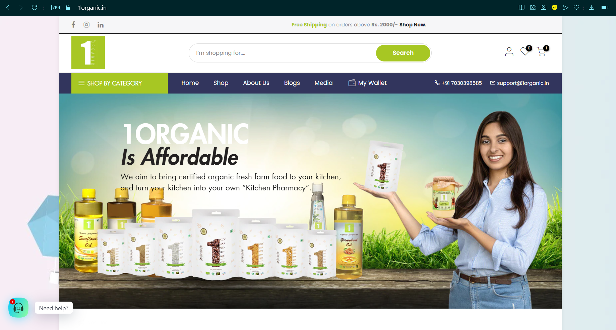
LIVE-PROJECT
Prabkrishna Techs Company is currently working on “1organic.in” which is an E-commerce website for selling organic food online.
Food categories range from lentils, grains, and cereals to cold-pressed oils and face masks.

Slide 8
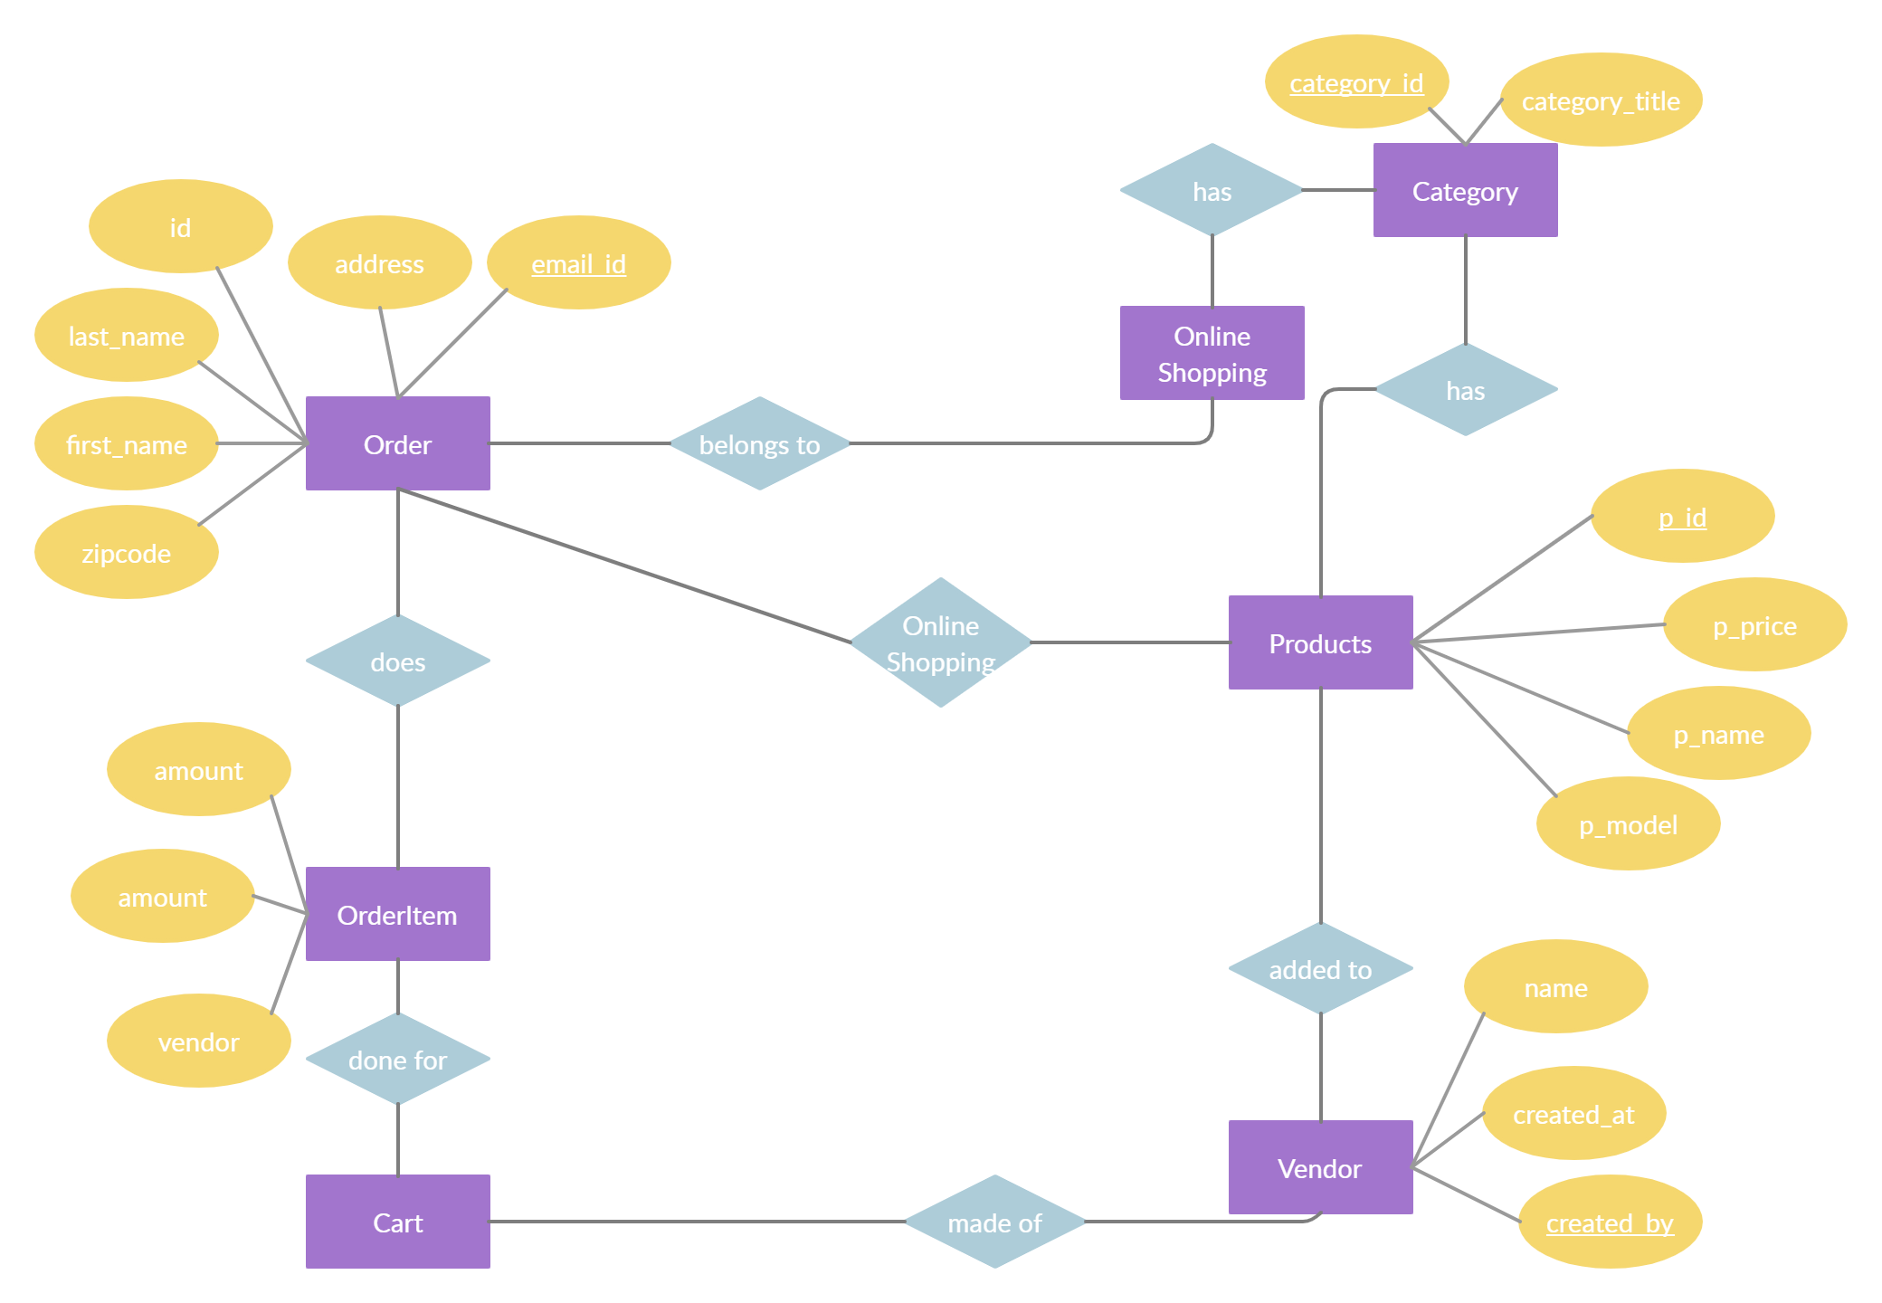
DESIGN CONSIDERATIONS: ER DIAGRAM

Slide 9
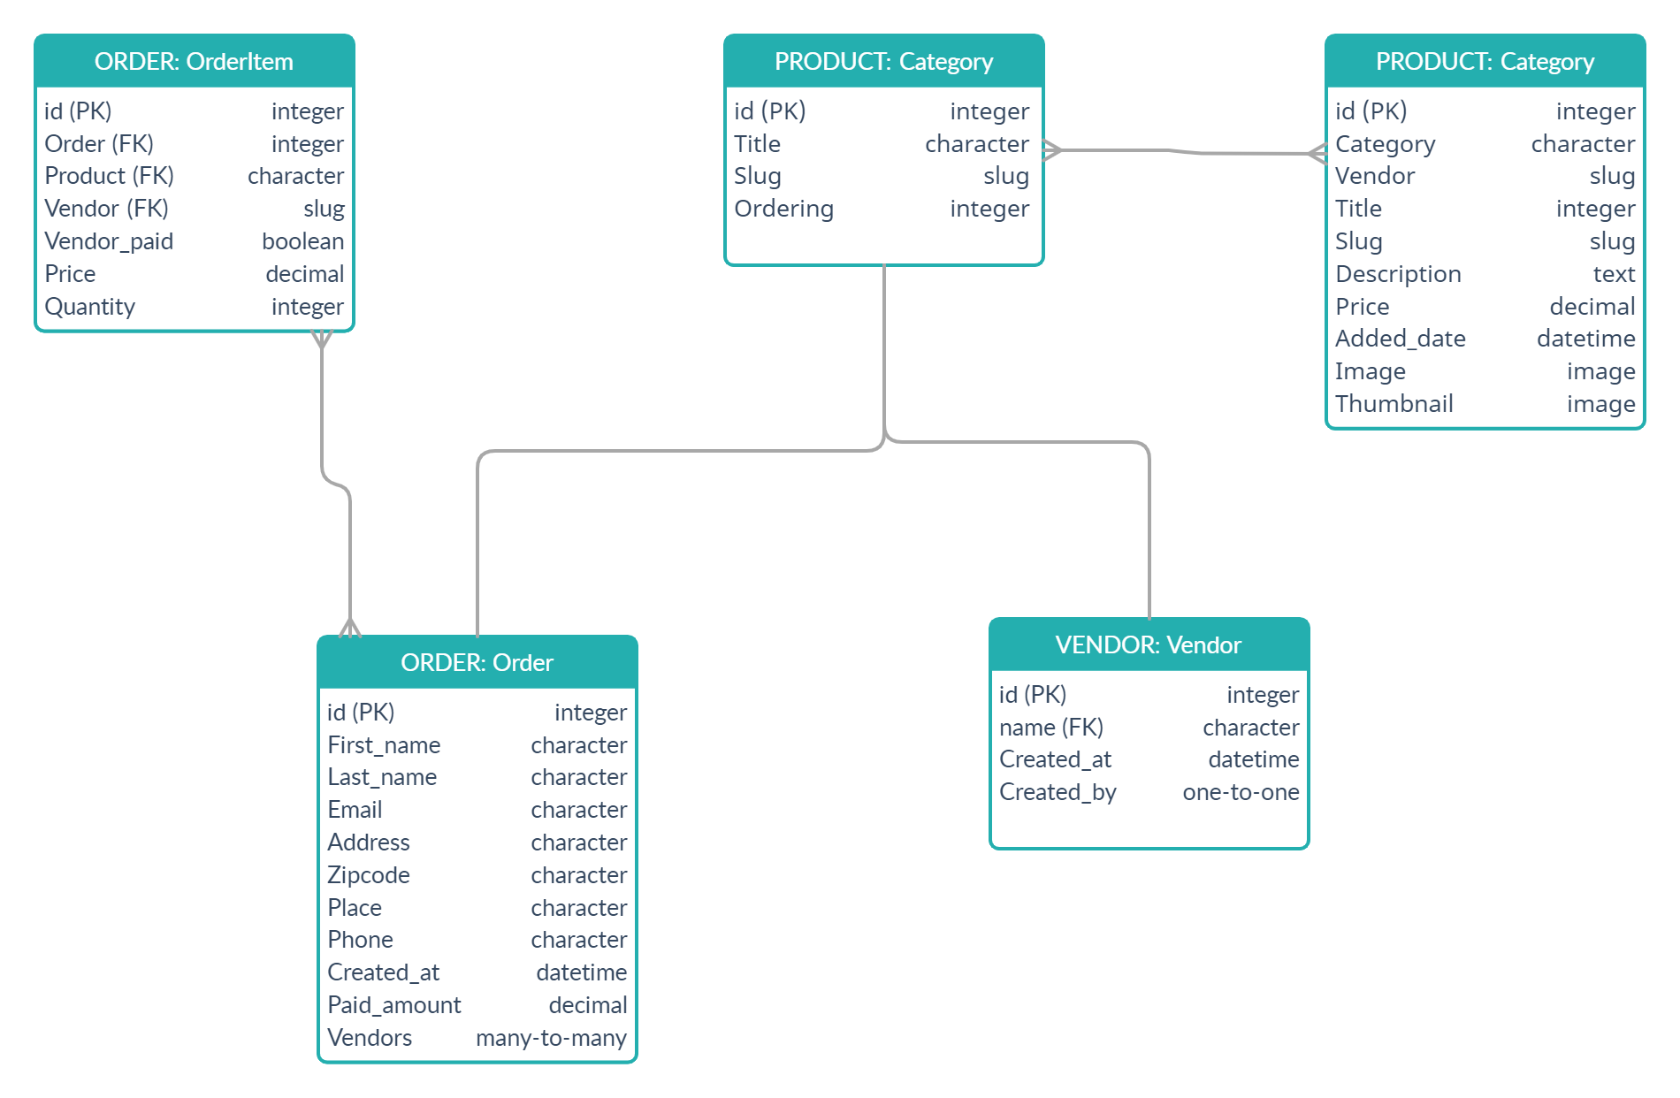
DESIGN CONSIDERATIONS: UML DIAGRAM

Slide 10
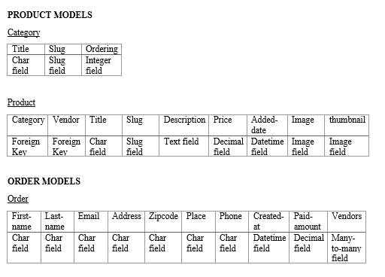
DESIGN CONSIDERATIONS: DATABASE SCHEMA

Slide 11
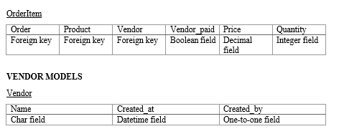
DESIGN CONSIDERATIONS: DATABASE SCHEMA

Slide 12
TASK PERFORMED
Starting the Django Project using a command prompt terminal.
Creating and migrating database models.
Creating the administration portal.
Creating views and templates.
Creating user interface using HTML and CSS.
Run Server on local host port 8000.
Uploading project to github repository.

Slide 13
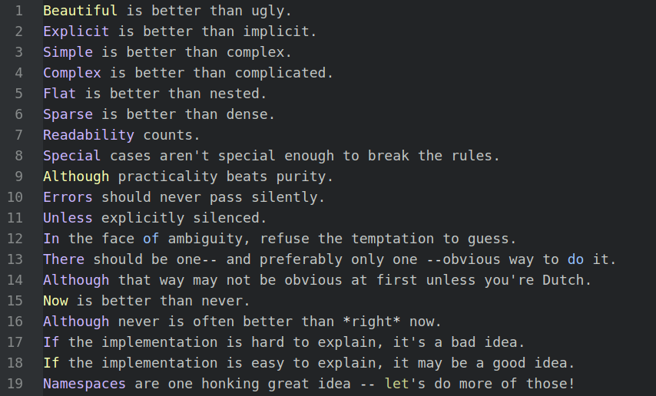
WHY DJANGO? ZEN OF PYTHON

Slide 14
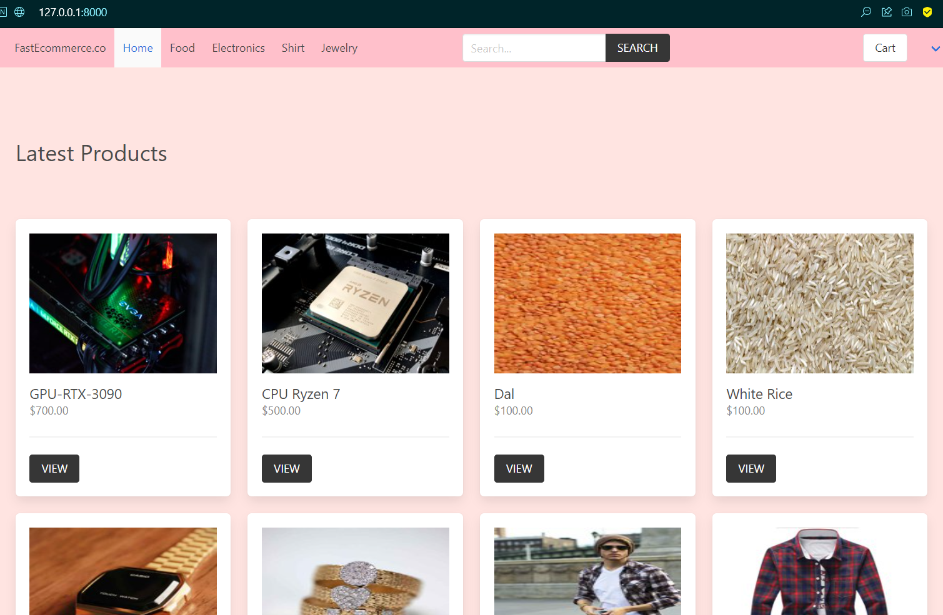
RESULTS HOME PAGE

Slide 15
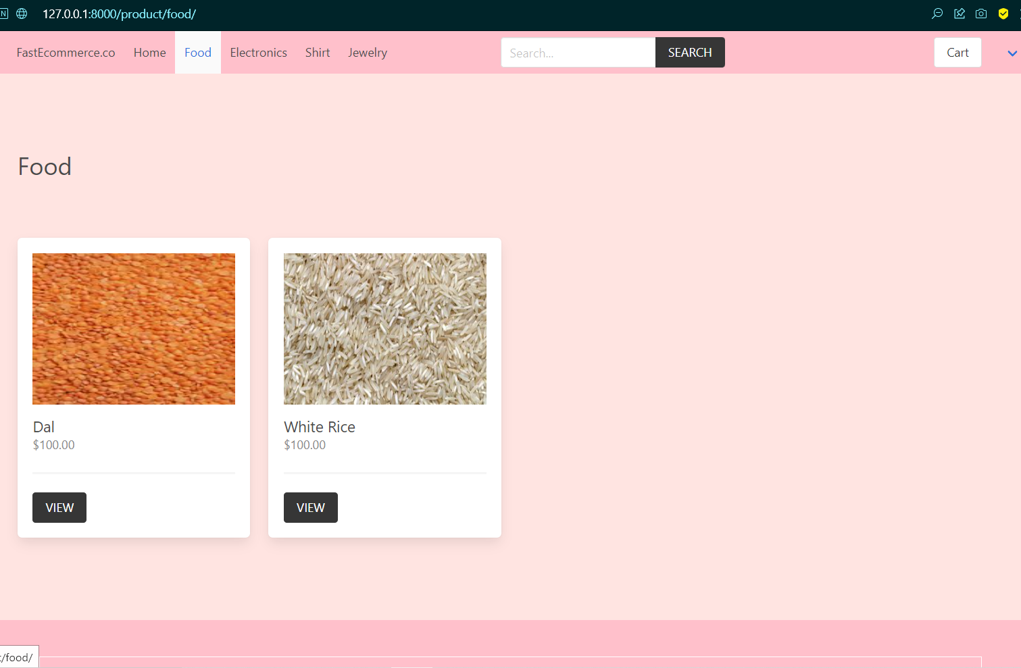
RESULTS FOOD PAGE

Slide 16
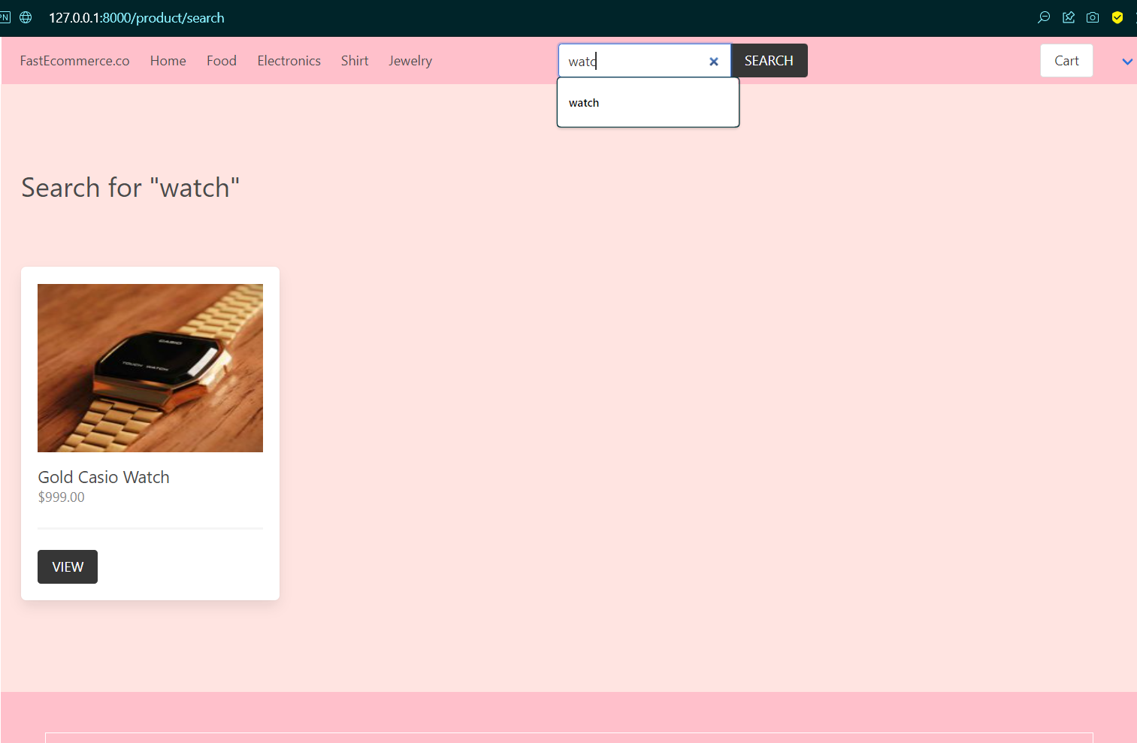
RESULTS SEARCH PAGE

Slide 17
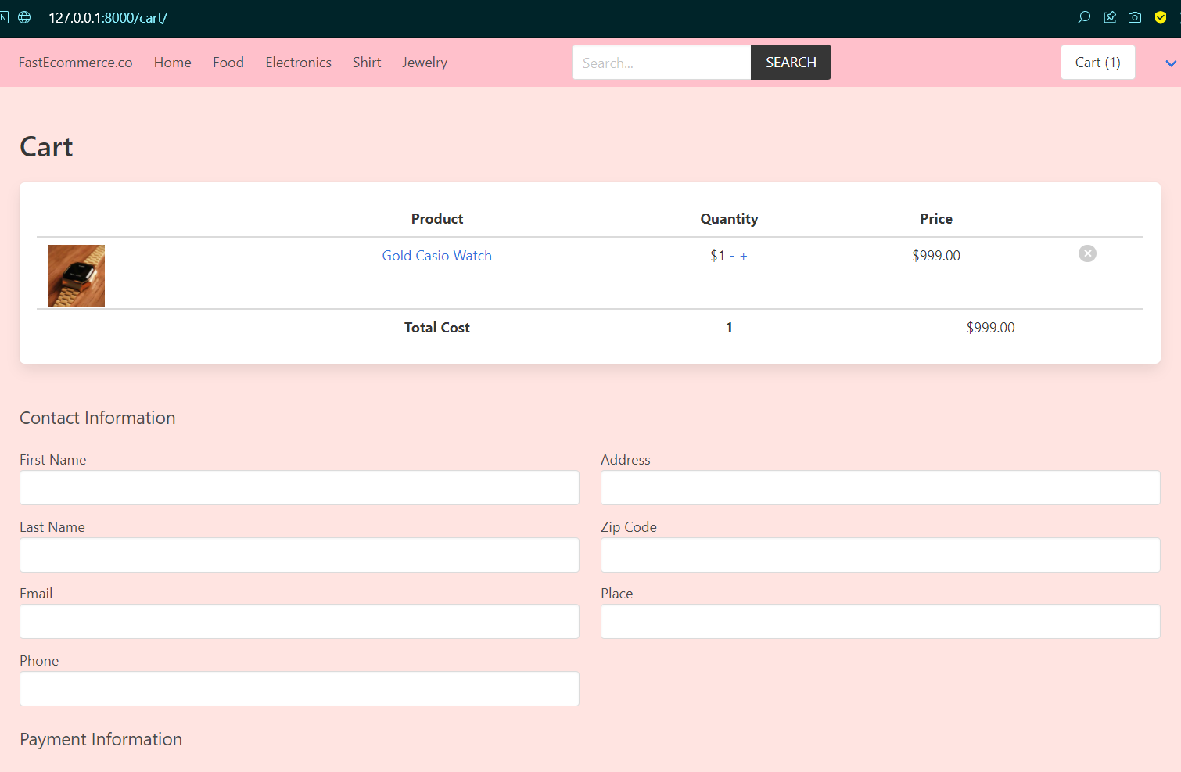
RESULTS SHOPPING CART

Slide 18
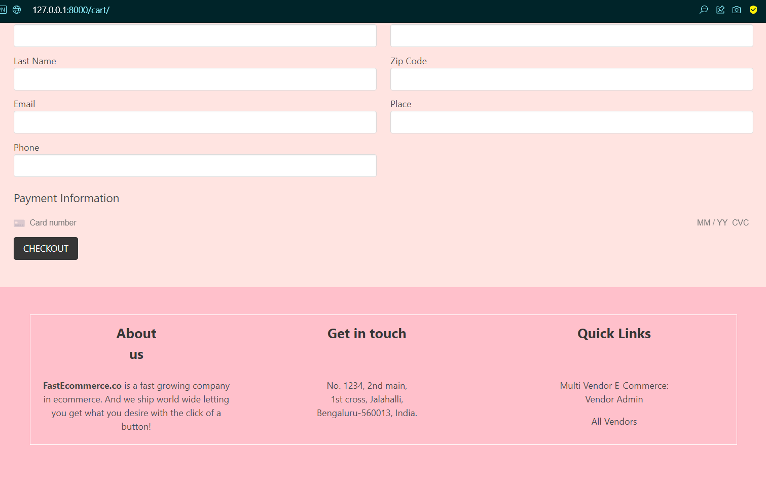
RESULTS CHECKOUT PAGE

Slide 19
CONCLUSION
With the rise of a new scenario post-pandemic, many start-ups and online businesses have emerged, bringing along with them a new requirement for online websites where the consumer can order products online, on their mobile or computers.
This makes it easier for the vendors to manage their inventory as well as handle shipping safe and securely. The key to successfully attracting consumers is a well-built, visually appealing website, with fully functional features and easy to comprehend user interface.
The user can securely login onto the website and can order products or if he wishes he can be a vendor and sells his own products online.
The Django web development framework has made the process of creating web applications much easier than ever. The convince of just being able to install all the components pre-built which gives it the template effect is greatly efficient and time-saving. What used to be a team’s work is now just at the convenience of a single web developer.

Slide 20
FUTURE ENHANCEMENT
I was trusted with the task of creating a basic e-commerce website from scratch, which I believe I have implemented successfully under the guidance of my mentor. Although it might not be as advanced as the current popular e-commerce website such as Amazon or Flipkart, it is still possible to implement the latest features.
With the addition of the auto-suggestion module and product filtration based on price history, featured products, size, quantity, etc.
It is also possible to implement a chatbot through API or as a component in the Django framework template. For now, these are the enhancements I would choose to make in the future.

Slide 21
REFERENCES
[1] Python Crash Course_ A Hands-On, Project-Based Introduction to Programming, by Eric Matthes.
[2] Adrian Holovaty, Jacob Kaplan-Moss; et al. The Django Book. Archived from the original on 2 September 2016. Retrieved 3 September 2013. Django follows this MVC pattern closely enough that it can be called an MVC framework.
[3] Django's release process - Django documentation - Django".
[4] "Introducing Django". The Django Book. Archived from the original on 29 July 2018.
[5] "Django 3.2 release notes | Django documentation | Django". 6 April 2021.
[6] "Template::Swig - Perl interface to Django-inspired Swig templating engine. - metacpan.org". metacpan.org.
[7] "Django CMS - Enterprise Content Management with Django - Django CMS". www.django-cms.org.
[8] For running the project: http://localhost:8000
[9] https://docs.djangoproject.com/en/4.0/
[10] https://en.wikipedia.org/wiki/Django_(web_framework)
[11] https://docs.djangoproject.com/en/4.0/ref/models/relations/

